Slide 1


Academic Decathlon
Coach Chauvin – L226
Ms. Burke – J216

Slide 2

African Student Association
Ms. Osun
Coach Griffin – E123

Slide 3
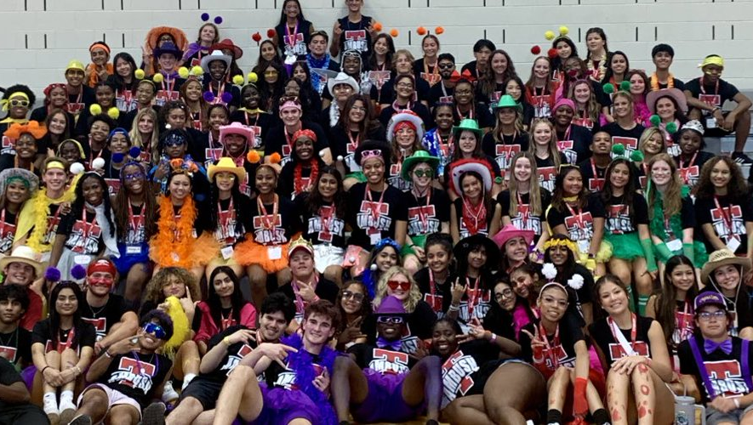
Ambush
Ms. Martinez – E138

Slide 4

Anti-Human Trafficking Club
Mr. Scheuerman – L239

Slide 5

Art Club
Ms. Mansour – I125
Ms. Albritton – T206
Ms. Prescott – I121

Slide 6

Astronomy
Club
Ms. Rebeles – L204

Slide 7

Best
Buddies
Ms. Kunai – E102

Slide 8

Black Student
Union
Ms. Lewis – K204
Ms. Myles –
Counselors’ Suite

Slide 9

Book
Club
Ms. Spina - Library

Slide 10

Chinese Student
Association
Ms. Hodge – E100

Slide 11

Christian
Student Union
Coach Sapp – B111
Coach Terwelp – C112

Slide 12
Class of ‘25
Coach Barker – C117
Coach Kessler –
Small Gym

Slide 13
Class of ‘26
Ms. Garrett – L227

Slide 14
Class of ‘27
Coach Kessler – Small Gym
Coach Khan – J213

Slide 15
Class of ‘28
Ms. Garrett – L227
Ms. Hodge – E100

Slide 16

Coloring
Club
Mr. Lodini – C122

Slide 17

Computer Science Honor Society
Mr. Thom – K203

Slide 18

Creative
Writing Club
Mr. Lauver-Garza – L207

Slide 19

DECA
Ms. Oneil – K206

Slide 20

Drama
Club
Ms. Swafford – H108
Ms. Barron – H108

Slide 21

Engineering
Club
Mr. Woldeyesus – K201

Slide 22

Filipino Student
Association
Ms. Abarado-Remijio –
Counselors’ Suite
Mr. Howell – C127

Slide 23

French
Club
Mdm. Bolanos – T110

Slide 24

French Honor
Society
Mdm. Bolanos – T110

Slide 25

Future Farmers of America
Ms. Dohnalik – D106

Slide 26

German
Club
Herr Hulse – T101

Slide 27

Girls Who
Code
Mr. Thom – K203
Ms. Spina - Library

Slide 28

Guitar
Club
Mr. Gomez – L210

Slide 29

Hallyu
(Korean Club)
Ms. Taracido – T104

Slide 30

HOSA
Ms. Carpe – G101
Ms. Jones – G103

Slide 31

Helping
Hands
Ms. Mansour – I125

Slide 32

Hispanic Student
Association
Ms. Itzep – T103
Ms. Marrugo – T107

Slide 33

Interact
Club
Ms. Barker – C117
Ms. Cordova – C124

Slide 34

International
Thespian Honor Society
Ms. Swafford – H108
Ms. Barron – H108

Slide 35

Japanese
Club
Ms. Franklin – T105

Slide 36

Japanese
Honor Society
Ms. Franklin – T105

Slide 37

Key
Club
Mr. Lee – C120

Slide 38

Leo
Club
Coach Griffin – E123

Slide 39

Mental Health
Club
Ms. Clark & Ms. Stephenson –
Counselors’ Suite

Slide 40

Mock Trial
Coach Garcia – J223

Slide 41

Model United
Nations
Ms. Cain – L241

Slide 42

Mu Alpha
Theta
Ms. Hodge – E100

Slide 43

Muslim Student
Association
Ms. Hodge – E100

Slide 44

National Art
Honor Society
Ms. Albritton – I206

Slide 45

National
Beta Club
Ms. Hisaka – P205

Slide 46

National English
Honor Society
Ms. Foreman – L215

Slide 47

National
Honor Society
Ms. Lodini – C122

Slide 48

National Honor Society of Sports Medicine
Coach Jones –
Field House

Slide 49

National Technical Honor Society
???

Slide 50

Nerdy Girl
Success
Ms. Carpe – G101

Slide 51
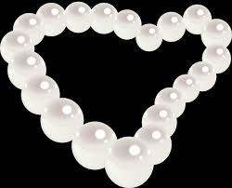
PEARLS
Ms. Hill – B115

Slide 52

Photography & Videography Club
Ms. Hill – B115

Slide 53

Pride
Club
Mr. Householder –
P222

Slide 54

Red
Cross
Mr. Hindmarch –
L202
Ms. Burke – J216

Slide 55

Rho
Kappa
Ms. Joseph – P219

Slide 56

Science National Honor Society
Coach Robertson – J205

Slide 57

Science Olympiad
Coach Robertson – J205
Mr. Wang – B113

Slide 58
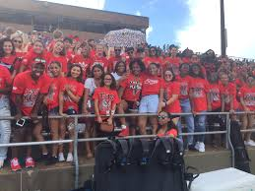
Scream
Team
Coach Barker – C117

Slide 59

South Asian Student Association
Ms. Joseph – P219

Slide 60

Spanish National Honor Society
Sra. Taracido – T104

Slide 61

Speech &
Debate
Ms. Thorpe – T205

Slide 62

Student
Council
Ms. Garrett – L227

Slide 63

Table Top Gaming Club
Mr. Householder – P222

Slide 64

Texas Association of Future Educators
Dr. Kibler – D101

Slide 65


Tigerettes
Mr. Roberts – L224

Slide 66

Travis Wellness Coalition
Ms. Stephenson & Ms. Clark –
Counselors’ Suite

Slide 67

TraviSTEM
Mr. Scheuerman – L239

Slide 68

Tri-M Music Honor Society
Ms. Behrens – I101

Slide 69

UIL
Academics
Ms. Malik – J204

Slide 70

Ultimate Frisbee Club
Mr. Householder – P222
Mr. Hindmarch – L202

Slide 71

Vietnamese Student Association
Mr. Lee – C120

Slide 72

YES
Program
Ms. Kidwell –
Ms. Butler –
Counselors’ Suite

